Slide 1
Company Presentation
August 2022

Slide 2
An introduction to Rusta

Slide 3
The Rusta Founders
Anders Forsgren and
Bengt-Olov Forssell
Our entrepreneurial heritage
shape our way of working

Slide 4
Our Business Concept
We want our customers to feel welcome, be inspired and enjoy shopping with us. At Rusta, we make it easy for large numbers of people to buy good quality home and leisure products at the best prices.

Slide 5
Rusta: A summary
Privately owned
Headquarters in Stockholm, Sweden
AAA-rated
Consolidated net sales FY21: 9,471 MSEK
190 stores in Sweden, Norway, Finland and Germany
One common range and store format
4,384 co-workers in seven countries
1,600,000 customers visiting our stores at least once per month
Three sourcing offices across Asia
Central warehouse in Norrköping (operational since 2015)
No franchise, no agents

Slide 6
Our story is one of pride and success!
1986
1990
1998
2000
2001,2004
2006-2010
2008
2011
2013
2014
2015
2016
2017
2018
2019
2020
2021
Rusta is founded in Gävle, Sweden
10 Stores
First quality & sourcing office in China
25 Stores
First warehouse in Landsbro and later additional in Nässjö
Quality & sourcing offices in Beijing, Shanghai and Bangkok
50 stores
25 Years! More than 60 stores
Quality & Sourcing office in India
75 Stores and 1st store in Norway
New DC in Norrköping replaces warehouses in Landsbro and Nässjö
Rusta 30 Years, 100 Stores and new sourcing office in Vietnam
First store in Germany
Rusta acquires Hong Kong and enters Finland
160 Stores and growing
Over 3.000.000 club members
Rusta 35 Years and with more than 180 stores.
Hangzhou
Delhi
Ho Chi Minh City

Slide 7
Our Vision Make Rusta the leading and most trusted low-price retailer in Europe.

Slide 8
Our Promise
We make it easy to refill and renew at home. Always at surprisingly low prices.

Slide 9
Simplicity
It does not get simpler than Rusta.
Togetherness
One Rusta – Us together.
Courage
We dare, therefore we win.
Commitment
We are Rusta. And we are proud of it.
Our Values

Slide 10
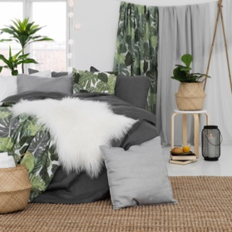
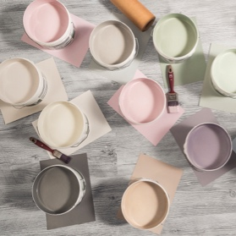
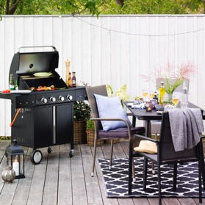
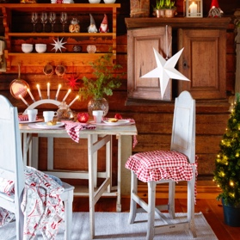
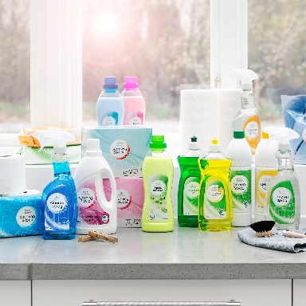
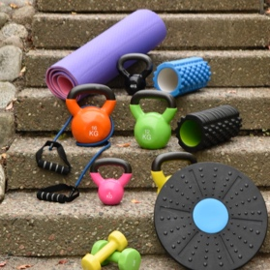
Our Offering
An attractive and always available core mixed with inspirational and ever-changing seasonal products.
Home & Decoration
DIY
Garden
Christmas
Beauty
Leisure

Slide 11
Focus on sustainability
At Rusta, we take our sustainability work very seriously.
We work according to the UN's global goals as a guiding principle and our sustainability work includes many different areas; production, distribution, working conditions, climate and environment.
We want it to be easy for the consumer to do the right thing. Therefore, a large part of the work is already done when our customers come into our stores.
We believe that it should be possible to make sustainable choices at the lowest price. It should not be expensive to choose sustainably.
Our vision to become the most reliable low-price retailer is an obvious ambition. It should be possible to trust Rusta.

Slide 12
Three sourcing offices with 99 Rusta employees
Rusta maintain a highly competent purchasing organization with a strong local presence in Asia.
By working directly with manufacturers, we establish close cooperation, working together to find the best solutions in terms of function, quality and price.
All purchasing in Asia is handled by our own sourcing offices in China, India and Vietnam.
Purchasing in Europe is handled by our Head Office in Sweden.
Rusta has started evaluating new sourcing markets to offer better products to our customers at surprisingly low prices.
Hangzhou
New Delhi
Ho Chi Minh City

Slide 13
One central warehouse
Located in Norrköping, Sweden and workplace for over 400 emplyees.
120,000 m² working area, 8,500 m² automated high bay with a height of 38 meters and easy accessed by boat, train or cargo.

Slide 14
The Rusta Expansion

Slide 15
Twice the size every five years
The average growth of Rusta since 1986

Slide 16
210 Stores soon!!
Growth Potential
We have 190* stores in Sweden, Norway and Finland combined, targeting 20 million inhabitants. In Germany, with over 80 million inhabitants, we currently have 6 stores and more coming up.
108
No. of
Stores
2022
6
41
35
*The number of stores by August 2022. 13 new stores set to be opened during 2022.

Slide 17
Club Rusta Our customer club drives loyalty and sales
36 Million receipts & 80 Million visitors in FY 2021-22
4,500,000
Members!
Since launching in 2017 Norway and in 2020 Finland, Club Rusta has now over 35% of its members outside of Sweden.

Slide 18
One Rusta – Us together
This is Rusta. More than 4300 colleagues in seven countries are dedicated to our customers. Every day.

Slide 19
Thank you!

